Slide 1

University of New Haven Fall 2022 AI Project
Presented By: Professor:
Shiva Ram Reddy Rikka- 00759744 Dr. Shivanjali Khare
Rohith Gottipati- 00751580
Gayathri Chilukuri- 00755590
Academic Year: 2022/2023

Slide 2
Presentation Plan
AI Project
Project Objectives
Deliverables
Evaluation Methodology
Conclusion

Slide 3
AI Project Brain Tumor Detection
We considered many fields, topics, and subjects to work on for our Ai project; there is a lot of interesting stuff out there.
We decided on the topic of brain tumor detection because many people suffer from this disease and brain tumor detection with AI can assist many doctors with their diagnostics, which is why I chose it.
Brain tumors are regarded as one of the most dangerous diseases in both children and adults. Brain tumors constitute 85 to 90% of all primary Central Nervous System (CNS) tumors. Each year, approximately 11,700 people are diagnosed with brain tumors. The 5-year survival rate for people with a cancerous brain or CNS tumor is around 34% for men and 36% for women.

Slide 4
Project Objectives
Find
Find a dataSet
Find
Find a model
Train
Train the model on the dataset
Execute
Execute the model into the dataset
Discuss and show
Discuss and show the results

Slide 5
Approach
To achieve automatic brain tumor detection, we chose to use artificial intelligence AI that uses deep learning, which is an artificial neural network, or CNN, to be more precise.
A convolutional neural network (CNN) is a type of artificial neural network that is specifically designed to process pixel data in image recognition and processing.
CNNs are powerful image processing, artificial intelligence (AI) systems that use deep learning to perform both generative and descriptive tasks, frequently using machine vision to recognize images and videos.
After creating the CNN, we will train it on the data set so that the model can distinguish between tumorous and non-tumorous images.
The training set will use the 2 first settings, training, and validation, and we can save the Test set for evaluating our model because it would be inappropriate to test the model on data that he has already seen because he will predict them with 100% accuracy.
Following the previous step, we will test our model in the test set and see what the results are, and then we will be able to determine whether our model is good or bad.

Slide 6
Deliverables
Data set
Code in a notebook
Screen Shot for the execution
The model after training

Slide 7
Evaluation Methodology
First, we present our model using CNN and only a few fully connected layers.
The total number of parameters in the model is described.
We then begin training our model, and once we have finished training it, we evaluate it to see if it is a good model or needs improvement.
We evaluate the model's accuracy by looking for a larger DATASET to see if it is good or bad, and if any changes need to be made, we improve it accordingly.

Slide 8
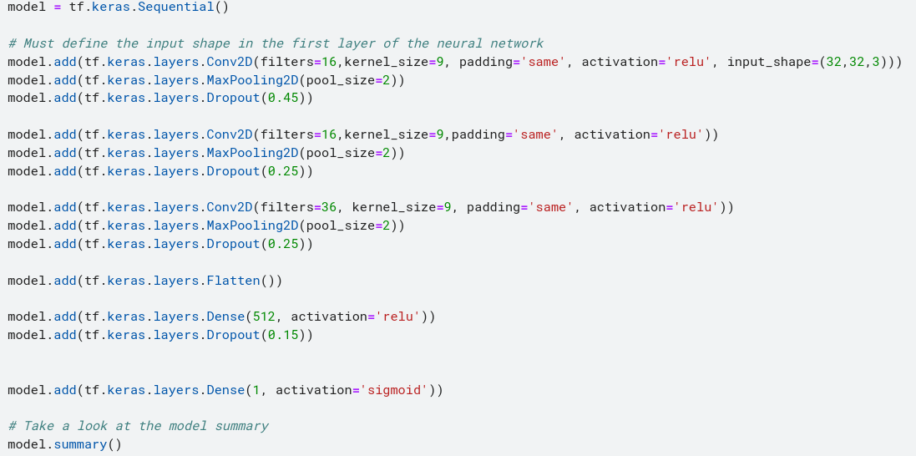
Here is the following model that was created via CNN with fully connected layers.

Slide 9
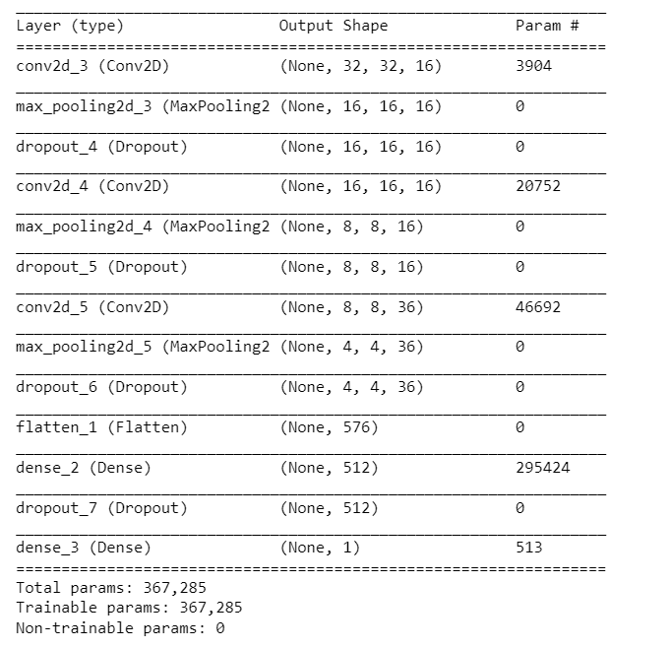
And here is the result for the model summary that shows our model in detail and specifies the total parameters of the model

Slide 10
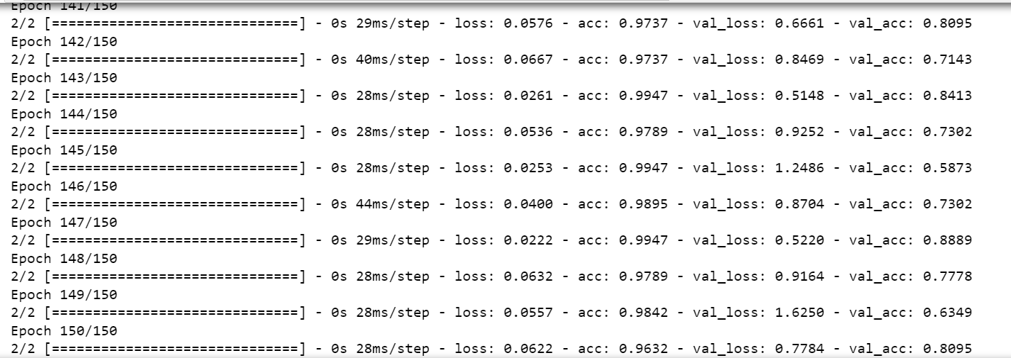
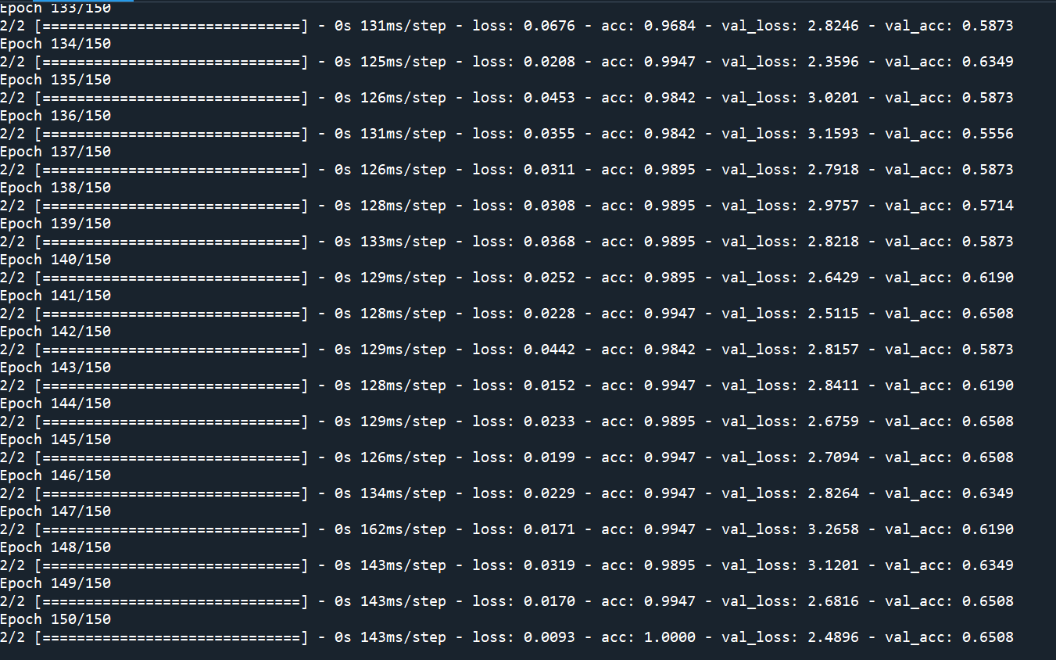
Then we start training our model for epochs just as shown in the figure below

Slide 11
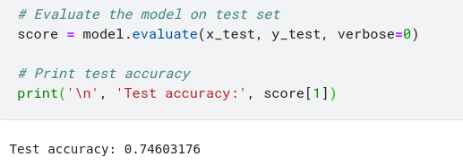
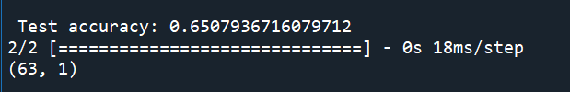

After we finish training our model we now go to the part where we evaluate our model to see if it's a good model or if it needs improvements. As we can see the accuracy of our model is at 80% it is not that bad but it’s good and we can still improve this result by looking for a bigger DATASET.

Slide 12
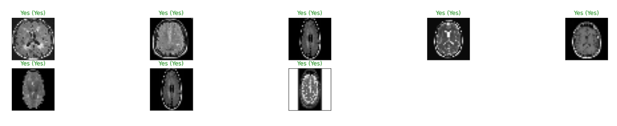
and here are some results for the model when we run it on the test pictures between the brackets is the correct prediction so we can say that our model gave pretty good results

Slide 13
Conclusion
This project was a hybrid of a CNN model classification problem (predicting whether or not a subject has a brain tumor) and a computer vision problem (to automate the process of brain cropping from MRI scans).
The final accuracy is significantly higher than the 50% baseline (random guess). It could, however, be increased by increasing the number of train images or by tuning the model hyperparameters.

Slide 14
Thank You

